Slide 1



CARBON CAPTURE
WEEK 4
Economics and Policy relating to Carbon Capture

Slide 2


DAY - 4

Slide 3


Estimation of Capital Costs and Cash Costs for Demo Scale CCUS Projects
To support the development of Carbon Capture, Utilization, and Storage (CCUS) in India, it is essential to fund and support demonstration-scale projects across various sectors. The estimation of capital and operational (cash) costs for these projects is detailed below, considering Indian conditions and costs, along with the currently available technologies.
The capital and cash costs are estimated on the basis of key assumptions like --

Slide 4
-Retrofitting-carbon capture projects will be integrated into existing plants or units, rather than building new infrastructure from scratch
-All cost parameters are based on the current state of technology and economic conditions in India
–The power needed for the carbon capture process will be supplied by the existing operations of the plants.
–Manpower, solvent make-up, consumables, repair and maintenance, cooling water, and make-up water costs are factored based on normative Indian conditions and costs.
–The capital costs encompass all hard and soft costs, including taxes, duties, owner’s costs, and financing costs. And is calculated assuming an 8% financing cost and a project lifespan of 20 years.

Slide 5
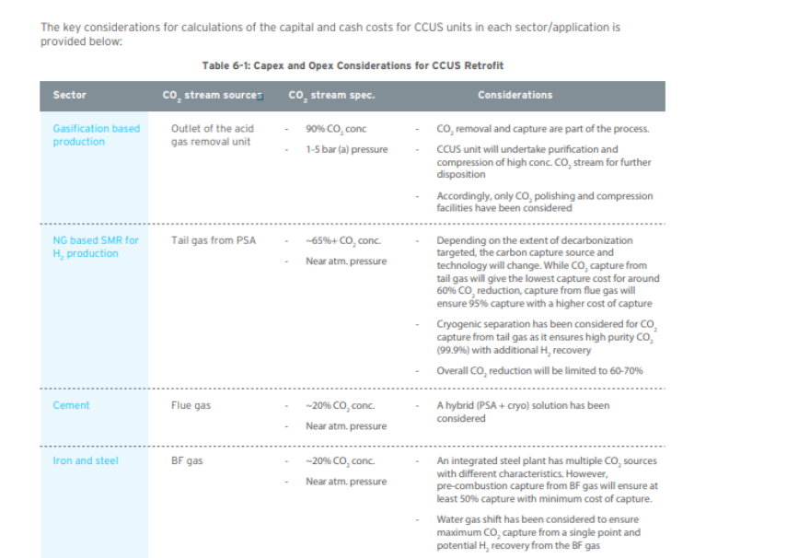

The oversized carbon disposition infrastructure would be too large for single users but rather be designed for multiple users/emitters.

Slide 6
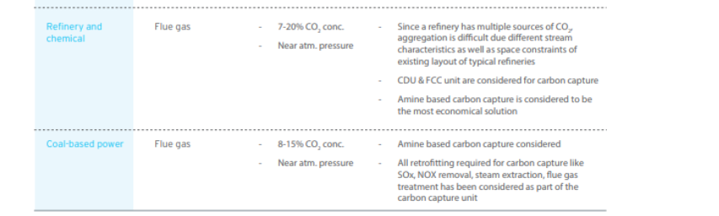
Contd.
The oversized carbon disposition infrastructure would be too large for single users but rather be designed for multiple users/emitters.

Slide 7
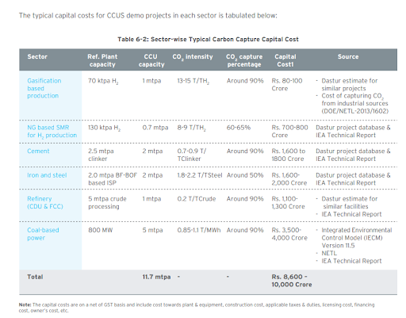

Slide 8
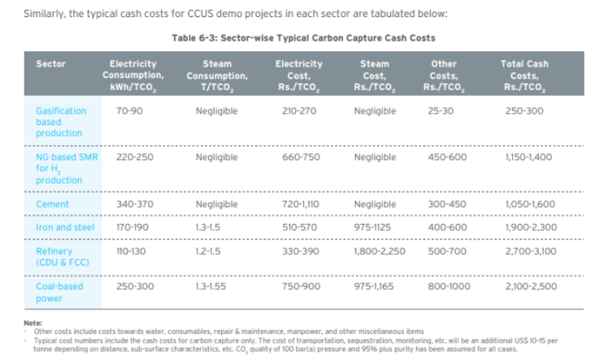

Slide 9
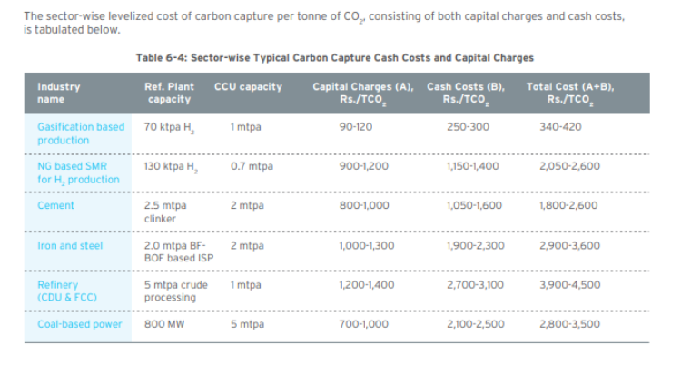

Slide 10




Aggregate CCUS Investment Requirements at Country Level
CO2 emissions in India from the hard to abate sectors like steel, cement, coal-based power, chemical, etc. is estimated to reach around 2,300 mtpa by the year 2030
To achieve significant CO2 abatement in India by 2030, substantial investments in CCUS are required. Two scenarios have been outlined: the base case targeting 20 million tonnes per annum (mtpa) of CO2 capture, and the optimistic case aiming for 35 mtpa. These investment estimates consider sector-specific capital costs for carbon capture, transportation pipelines, and sequestration, taking into account industry type, ease of implementation, and cost impacts

Slide 11
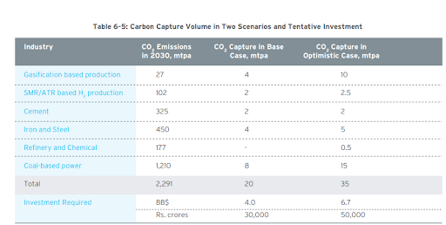
The carbon capture volumes under the two scenarios are given in Table.
The type of industry, the ease of implementation and likely cost impact has been considered while estimating the capital costs for each industry.

Slide 12





The likely required investment in carbon capture will be 4 BB$ (Rs. 30,000 crores) to 6.7 BB$ (Rs. 50,000 crores), depending on the carbon capture volume. An additional amount of around 1.5 BB$ (Rs. 11,000 crores) to 2.5 BB$ (Rs. 19,000 crores) will be necessary for the transportation and storage infrastructure.
These estimates are based on the installation and costs of the best and commercial-scale technologies currently available. The investment can reduce with strategic aggregation at scale and the usage of common CCUS infrastructure. Further, improved scale and breakthrough novel technologies can also reduce the costs significantly.

Slide 13

CCUS Financing Mechanism
In the absence of any tax incentives or supporting market conditions for low carbon footprint products, emerging ‘low-carbon’ technologies cannot compete with traditional fossil fuel-based technologies. Under such scenarios, deploying public procurement programmes that favor low-carbon products or ensure a guaranteed minimum price for products generated from CCUS equipped operations, along with CO2 tax credits, can provide the foundations of a level playing field for investors.
Incentives from the Government in the form of tax credits, cash credits, or Product Linked Incentives (PLI) can boost CCUS technology implementations. Figure 6-3 shows how incentives can create a level playing field for CCUS projects. Also, incentivizing investments through capture credits enables progressive reduction of capture costs and establishes markets for low carbon-based products.

Slide 14
CCUS Financing Mechanism
The decarbonization costs will have a varying impact on the unit cost/price of products in different industries, viz. power, cement, steel, etc. Hence it is suggested to have a well-considered policy that takes care of the CCUS cost structure in domestic and international markets and the decarbonization cost for each industry without compromising product competitiveness and India’s industrial and economic development goals.
An incentive for low-C production should be primarily guided by the following parameters:
a) Carbon capture/abatement cost;
b) CO2 emission intensity of the conventional process;
c) Cost structure of alternative process/production route (if any) for the production of green or low-C products; and
d) India’s energy security and sustainability goals.

Slide 15
CCUS Financing Mechanism
As a signatory of the Paris Agreement, India has committed to reducing CO2 emissions by 50% by 2050 and achieving net zero by 2070. To contribute significantly towards these goals, it is envisioned that at least 30% of emissions should be captured through CCUS projects. This translates to a CCUS target volume of 750 million tonnes per annum (mtpa) by 2070.
Two financing options have been evaluated and analyzed for CCUS financing with the target CCUS volume of 750 mtpa. A general schematic has been presented in Figure 6-4. Financing Option 1: CCUS financing through only the ‘Clean Energy Cess’ Financing Option 2: CCUS financing through bond and gross budgetary support

Slide 16
CCUS Financing Mechanism
In both options, it is proposed to develop the CCFC with seed funding and support from the Government of India. The surplus funds will be re-financed to generate earnings at an 8-10% spread. The CCFC will subsidize the cash costs of CCUS projects through cash credit, while the capital charges will be subsidized as a tax credit. Since the cash credit and tax credit required for each industry will be different and critical for the adoption of CCUS, it is proposed to finalize the same based on CCUS demonstration projects based on different technologies, FEED study for the projects and discussion with industries. The tax credit created by the CCUS projects can be either availed by the parent company or can be sold in the ‘carbon market’.

Slide 17
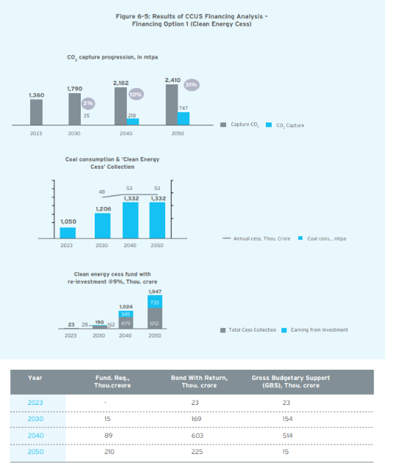

Slide 18
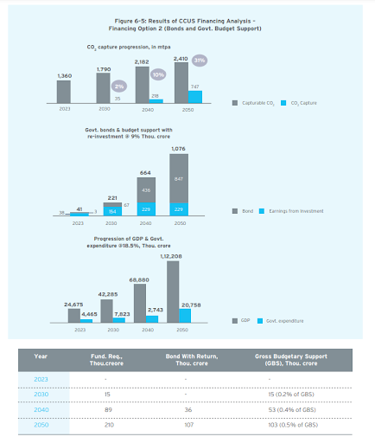

Slide 19

Carbon Capture Finance Corporation (CCFC)
It is proposed that the Government of India set-up a financial institution for the promotion and development of CCUS projects in India. The financial institution, which can be called the “Carbon Capture Finance Corporation (CCFC)” shall provide tax and cash credits for carbon capture projects in India. The CCFC may also participate in certain carbon capture projects through equity and debt funding & financing.
It is proposed that the CCFC shall extend both tax credits and cash credits to eligible CCUS projects; the tax credits shall be for the recovery of the capital costs and the cash credits shall be for the recovery of the operating costs of CCUS projects. In this context, it may be noted that similar incentives are already available in India for wind power projects. Wind power projects enjoy the benefit of Accelerated Depreciation (AD) with a 80% depreciation rate.

Slide 20
Carbon Capture Finance Corporation (CCFC)
Additionally, Generation Based Incentives (GBI) has also been available for wind power to the extent of INR 0.50 per kWh for the period of up to 31 March 2022. A similar combination is also envisioned for CCUS projects to maximize the envisaged CCUS outcomes
The 45Q tax credits offered in the USA may serve as a reference point for the level of tax credits offered for carbon capture utilization and sequestration projects. The recently enacted Inflation Reduction Act of 2022 has substantially enhanced the maximum level of credits available from US$ 50 to US$ 85 per tonne of CO2 sequestered. However, the level of credits are the same irrespective of the source and concentration of the CO2 captured and creates a disparity of incentives for different types of emitters, viz. an ethanol plant with almost 100% pure CO2 vs. a coal based power plant with 8-15% CO2 concentration in the flue gas stream.

Slide 21
Evaluation of Various Funding Sources
Green bonds are financial instruments specifically designed to raise capital for projects with environmental benefits. These bonds work similarly to traditional bonds but are earmarked for green projects
Since its inception, the green bond market has experienced significant growth, particularly in the last five years, driven by the commitment of nations and companies to achieve a net-zero economy. In 2021, investor participation surged, propelling the market to over USD 517 billion, up from USD 350 billion in 2020, marking its highest level ever. Developing nations and emerging economies, including India, are now introducing sovereign green bonds. India saw its highest issuance of green bonds in 2021, totaling USD 6.11 billion, and plans to launch sovereign green bonds in FY 2022-23. This move is expected to attract substantial foreign investment, which could be partially directed towards funding CCUS projects and cluster development, leveraging India's significant economic growth potential.

Slide 22
Evaluation of Various Funding Sources
Clean Technology Fund (CTF) The CTF fund is a USD 5.3 BB$ fund and a part of Climate Investment Funds. The fund is aimed at supporting low carbon technology and upscaling to mitigate long term GHG emissions. 85% of the funds are approved for projects in renewable energy, energy efficiency and clean transportation sector. The fund has supported low carbon projects in 19 countries. In India, the CTF investment plan is worth USD 775 MM$ and a large share of it has supported the development of 3 GW solar power capacity and supporting transmission infrastructure
The National Clean Energy and Environment Fund (NCEEF) -was established in the Finance Bill of FY 2010-2011 as the National Clean Energy Fund (NCEF). It is sourced from a cess on coal producers and importers, as well as industries like pan masala, tobacco, and aerated water, to support India's transition to a low-carbon economy. The fund finances renewable energy, energy efficiency projects, and has also identified CCUS and coal gasification projects as eligible for funding. However, these funds were diverted to support the Goods and Services Tax (Compensation to States) Act 2017, compensating states for potential losses due to GST implementation. This diversion is expected to end in 2026, after which the funds will be redirected to support low-carbon technologies and projects.

